Slide 1
What Is Association Mining?
Association rule mining:
  Finding frequent patterns, associations, correlations, or causal structures among sets of items or objects in transaction databases, relational databases, and other information repositories.
  Frequent pattern: pattern (set of items, sequence, etc.) that occurs frequently in a database [AIS93]
Motivation: finding regularities in data
  What products were often purchased together? — Beer and diapers?!
  What are the subsequent purchases after buying a PC?
  What kinds of DNA are sensitive to this new drug?
  Can we automatically classify web documents?

Slide 2
Why Is Frequent Pattern or Association Mining Important?
Foundation for many essential data mining tasks
  Association, correlation, causality
  Sequential patterns, temporal or cyclic association, partial periodicity, spatial and multimedia association
  Associative classification, cluster analysis, iceberg cube, fascicles (semantic data compression)
Broad applications
  Basket data analysis, cross-marketing, catalog design, sale campaign analysis
  Web log (click stream) analysis, DNA sequence analysis, etc.

Slide 3

Association Rule Mining
Given a set of transactions, find rules that will predict the occurrence of an item based on the occurrences of other items in the transaction
Market-Basket transactions
Example of Association Rules
{Diaper} → {Beer},
{Milk, Bread} → {Eggs,Coke},
{Beer, Bread} → {Milk},
Implication means co-occurrence, not causality!

Slide 4

Definition: Frequent Itemset
Itemset
  A collection of one or more items
    Example: {Milk, Bread, Diaper}
  k-itemset
    An itemset that contains k items
Support count (σ)
  Frequency of occurrence of an itemset
  E.g. σ({Milk, Bread,Diaper}) = 2
Support
  Fraction of transactions that contain an itemset
  E.g. s({Milk, Bread, Diaper}) = 2/5
Frequent Itemset
  An itemset whose support is greater than or equal to a minsup threshold

Slide 5



Definition: Association Rule
Association Rule
  An implication expression of the form X → Y, where X and Y are itemsets
  Example:
  {Milk, Diaper} → {Beer}
Rule Evaluation Metrics
  Support (s)
    Fraction of transactions that contain both X and Y
  Confidence (c)
    Measures how often items in Y
    appear in transactions that
    contain X
Example:

Slide 6
Basic Concepts: Frequent Patterns and Association Rules
Transaction-id | Items bought
10 | A, B, C
20 | A, C
30 | A, D
40 | B, E, F
Itemset X={x₁, …, x_{k}}
Find all the rules X→Y with min confidence and support
  support, s, probability that a transaction contains X∪Y
  confidence, c, conditional probability that a transaction having X also contains Y.
Customer
buys both
Customer
buys diaper
Let min_support = 50%, min_conf = 50%:
  A → C (50%, 66.7%)
  C → A (50%, 100%)
Customer
buys beer

Slide 7
Association Rule Mining Task
Given a set of transactions T, the goal of association rule mining is to find all rules having
  support ≥ minsup threshold
  confidence ≥ minconf threshold
Brute-force approach:
  List all possible association rules
  Compute the support and confidence for each rule
  Prune rules that fail the minsup and minconf thresholds
  ⇒ Computationally prohibitive!

Slide 8

Frequent Itemset Generation
Given d items, there are 2^{d} possible candidate itemsets

Slide 9
Closed Patterns and Max-Patterns
A long pattern contains a combinatorial number of sub-patterns, e.g., {a₁, …, a₁₀₀} contains (₁₀₀¹) + (₁₀₀²) + … + (₁¹₀⁰₀⁰) = 2¹⁰⁰ – 1 = 1.27*10³⁰ sub-patterns!
Solution: Mine closed patterns and max-patterns instead
An itemset X is closed if X is frequent and there exists no super-pattern Y כ X, with the same support as X (proposed by Pasquier, et al. @ ICDT’99)
An itemset X is a max-pattern if X is frequent and there exists no frequent super-pattern Y כ X (proposed by Bayardo @ SIGMOD’98)
Closed pattern is a lossless compression of freq. patterns
  Reducing the # of patterns and rules

Slide 10
Closed Patterns and Max-Patterns
Exercise. DB = {<a₁, …, a₁₀₀>, < a₁, …, a₅₀>}
  Min_sup = 1.
What is the set of closed itemset?
  <a₁, …, a₁₀₀>: 1
  < a₁, …, a₅₀>: 2
What is the set of max-pattern?
  <a₁, …, a₁₀₀>: 1
What is the set of all patterns?
  !!

Slide 11
Mining Association Rules
Example of Rules:
{Milk,Diaper} → {Beer} (s=0.4, c=0.67)
{Milk,Beer} → {Diaper} (s=0.4, c=1.0)
{Diaper,Beer} → {Milk} (s=0.4, c=0.67)
{Beer} → {Milk,Diaper} (s=0.4, c=0.67)
{Diaper} → {Milk,Beer} (s=0.4, c=0.5)
{Milk} → {Diaper,Beer} (s=0.4, c=0.5)
Observations:
All the above rules are binary partitions of the same itemset:
{Milk, Diaper, Beer}
Rules originating from the same itemset have identical support but
can have different confidence
Thus, we may decouple the support and confidence requirements

Slide 12
Mining Association Rules:
What We Need to Know
Goal: Rules with high support/confidence
How to compute?
  Support: Find sets of items that occur frequently
  Confidence: Find frequency of subsets of supported itemsets
If we have all frequently occurring sets of items (frequent itemsets), we can compute support and confidence!

Slide 13
Mining Association Rules
Two-step approach:
  Frequent Itemset Generation
    Generate all itemsets whose support ≥ minsup
  Rule Generation
    Generate high confidence rules from each frequent itemset, where each rule is a binary partitioning of a frequent itemset
Frequent itemset generation is still computationally expensive

Slide 14
Frequent Itemset Generation
Given d items, there are 2^{d} possible candidate itemsets

Slide 15

Frequent Itemset Generation
Brute-force approach:
  Each itemset in the lattice is a candidate frequent itemset
  Count the support of each candidate by scanning the database
  Match each transaction against every candidate
  Complexity ~ O(NMw) => Expensive since M = 2^{d} !!!

Slide 16
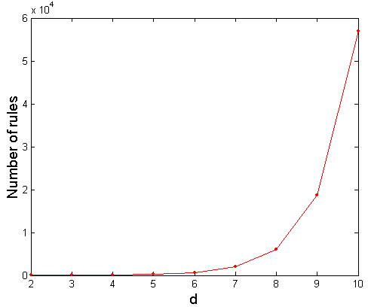
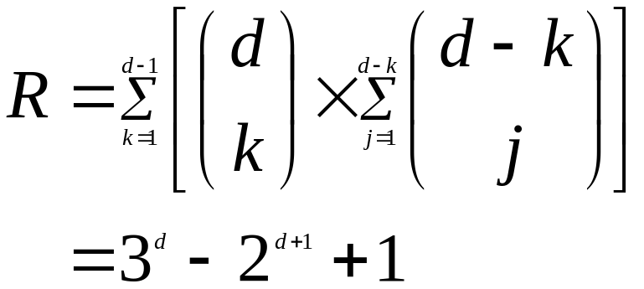
Computational Complexity
Given d unique items:
  Total number of itemsets = 2^{d}
  Total number of possible association rules:
If d=6, R = 602 rules

Slide 17
Frequent Itemset Generation Strategies
Reduce the number of candidates (M)
  Complete search: M=2^{d}
  Use pruning techniques to reduce M
Reduce the number of transactions (N)
  Reduce size of N as the size of itemset increases
  Used by DHP and vertical-based mining algorithms
Reduce the number of comparisons (NM)
  Use efficient data structures to store the candidates or transactions
  No need to match every candidate against every transaction

Slide 18
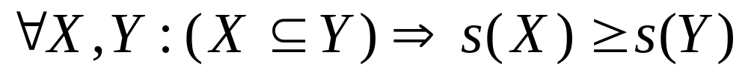
Reducing Number of Candidates
Apriori principle:
  If an itemset is frequent, then all of its subsets must also be frequent
  If {beer, diaper, nuts} is frequent, so is {beer, diaper}
  i.e., every transaction having {beer, diaper, nuts} also contains {beer, diaper}
Apriori principle holds due to the following property of the support measure:
  Support of an itemset never exceeds the support of its subsets
  This is known as the anti-monotone property of support

Slide 19


Illustrating Apriori Principle
Found to be Infrequent
Pruned supersets

Slide 20

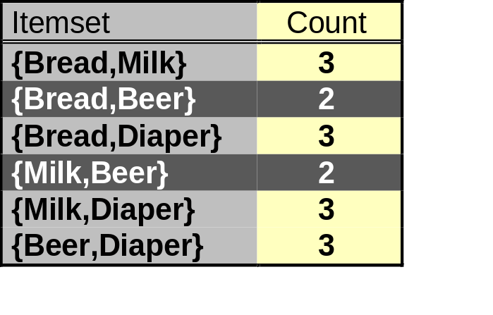
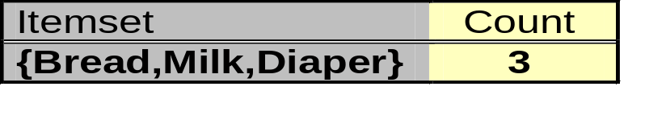
Illustrating Apriori Principle
Items (1-itemsets)
Pairs (2-itemsets)
(No need to generate
candidates involving Coke
or Eggs)
Minimum Support = 3
Triplets (3-itemsets)
If every subset is considered,
⁶C₁ + ⁶C₂ + ⁶C₃ = 41
With support-based pruning,
6 + 6 + 1 = 13

Slide 21
Apriori Algorithm
Method:
  Let k=1
  Generate frequent itemsets of length 1
  Repeat until no new frequent itemsets are identified
    Generate length (k+1) candidate itemsets from length k frequent itemsets
    Prune candidate itemsets containing subsets of length k that are infrequent
    Count the support of each candidate by scanning the DB
    Eliminate candidates that are infrequent, leaving only those that are frequent

Slide 22
The Apriori Algorithm—An Example
Sup_{min} = 2
Itemset | sup
{A} | 2
{B} | 3
{C} | 3
{D} | 1
{E} | 3
Database TDB
Itemset | sup
{A} | 2
{B} | 3
{C} | 3
{E} | 3
L₁
Tid | Items
10 | A, C, D
20 | B, C, E
30 | A, B, C, E
40 | B, E
C₁
1st scan
C₂
Itemset | sup
{A, B} | 1
{A, C} | 2
{A, E} | 1
{B, C} | 2
{B, E} | 3
{C, E} | 2
C₂
L₂
Itemset
{A, B}
{A, C}
{A, E}
{B, C}
{B, E}
{C, E}
Itemset | sup
{A, C} | 2
{B, C} | 2
{B, E} | 3
{C, E} | 2
2nd scan
C₃
Itemset
{B, C, E}
3rd scan
L₃
Itemset | sup
{B, C, E} | 2

Slide 23
The Apriori Algorithm
Pseudo-code:
    C_{k}: Candidate itemset of size k
    L_{k} : frequent itemset of size k
    L₁ = {frequent items};
    for (k = 1; L_{k} !=∅; k++) do begin
    C_{k+1} = candidates generated from L_{k};
    for each transaction t in database do
      increment the count of all candidates in C_{k+1} that are contained in t
    L_{k+1} = candidates in C_{k+1} with min_support
    end
    return ∪_{k} L_{k};

Slide 24
Important Details of Apriori
How to generate candidates?
  Step 1: self-joining L_{k}
  Step 2: pruning
How to count supports of candidates?
Example of Candidate-generation
  L₃={abc, abd, acd, ace, bcd}
  Self-joining: L₃*L₃
    abcd from abc and abd
    acde from acd and ace
  Pruning:
    acde is removed because ade is not in L₃
  C₄={abcd}

Slide 25
How to Generate Candidates?
Suppose the items in L_{k-1} are listed in an order
Step 1: self-joining L_{k-1}
  insert into C_{k}
  select p.item₁, p.item₂, …, p.item_{k-1}, q.item_{k-1}
  from L_{k-1} p, L_{k-1} q
  where p.item₁=q.item₁, …, p.item_{k-2}=q.item_{k-2}, p.item_{k-1} < q.item_{k-1}
Step 2: pruning
  forall itemsets c in C_{k} do
    forall (k-1)-subsets s of c do
      if (s is not in L_{k-1}) then delete c from C_{k}

Slide 26
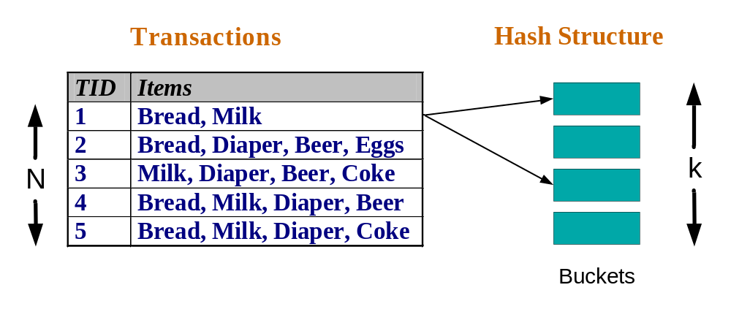
Reducing Number of Comparisons
Candidate counting:
  Scan the database of transactions to determine the support of each candidate itemset
  To reduce the number of comparisons, store the candidates in a hash structure
    Instead of matching each transaction against every candidate, match it against candidates contained in the hashed buckets

Slide 27
How to Count Supports of Candidates?
Why counting supports of candidates a problem?
  The total number of candidates can be very huge
  One transaction may contain many candidates
Method:
  Candidate itemsets are stored in a hash-tree
  Leaf node of hash-tree contains a list of itemsets and counts
  Interior node contains a hash table
  Subset function: finds all the candidates contained in a transaction

Slide 28
Generate Hash Tree
Suppose you have 15 candidate itemsets of length 3:
{1 4 5}, {1 2 4}, {4 5 7}, {1 2 5}, {4 5 8}, {1 5 9}, {1 3 6}, {2 3 4}, {5 6 7}, {3 4 5}, {3 5 6}, {3 5 7}, {6 8 9}, {3 6 7}, {3 6 8}
You need:
Hash function
Max leaf size: max number of itemsets stored in a leaf node (if number of candidate itemsets exceeds max leaf size, split the node)
Hash function
2 3 4
5 6 7
3,6,9
1,4,7
1 4 5
3 4 5
3 5 6
3 5 7
6 8 9
3 6 7
3 6 8
1 3 6
2,5,8
1 2 4
4 5 7
1 2 5
4 5 8
1 5 9

Slide 29
Association Rule Discovery: Hash tree
Hash Function
Candidate Hash Tree
1,4,7
3,6,9
2,5,8
2 3 4
5 6 7
1 4 5
1 3 6
3 4 5
3 5 6
3 6 7
Hash on 1, 4 or 7
3 5 7
3 6 8
1 2 4
1 5 9
6 8 9
1 2 5
4 5 7
4 5 8

Slide 30
Association Rule Discovery: Hash tree
Hash Function
Candidate Hash Tree
1,4,7
3,6,9
2,5,8
2 3 4
5 6 7
1 4 5
1 3 6
3 4 5
3 5 6
3 6 7
Hash on 2, 5 or 8
3 5 7
3 6 8
1 2 4
1 5 9
6 8 9
1 2 5
4 5 7
4 5 8

Slide 31
Association Rule Discovery: Hash tree
Hash Function
Candidate Hash Tree
1,4,7
3,6,9
2,5,8
2 3 4
5 6 7
1 4 5
1 3 6
3 4 5
3 5 6
3 6 7
Hash on 3, 6 or 9
3 5 7
3 6 8
1 2 4
1 5 9
6 8 9
1 2 5
4 5 7
4 5 8

Slide 32
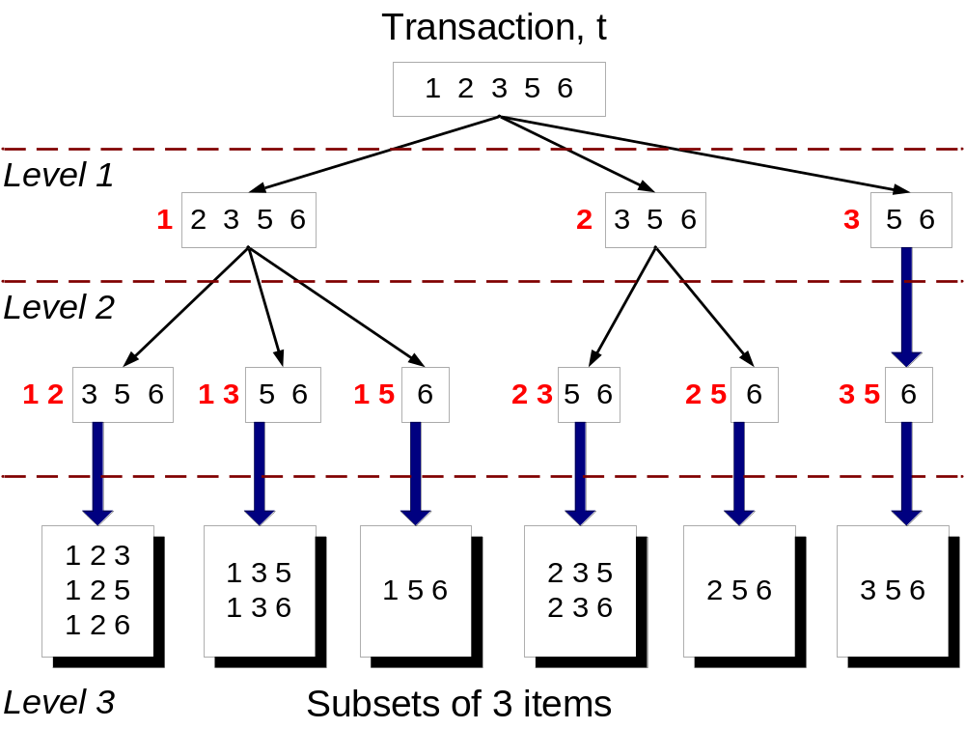
Subset Operation
Given a transaction t, what are the possible subsets of size 3?

Slide 33
Subset Operation Using Hash Tree
1 2 3 5 6
transaction
Hash Function
1 +
2 3 5 6
2 +
3 5 6
1,4,7
3,6,9
3 +
5 6
2,5,8
2 3 4
5 6 7
1 4 5
1 3 6
3 4 5
3 5 6
3 6 7
3 5 7
3 6 8
1 2 4
1 2 5
1 5 9
6 8 9
4 5 7
4 5 8

Slide 34
Subset Operation Using Hash Tree
1 2 3 5 6
transaction
Hash Function
1 +
2 3 5 6
2 +
3 5 6
1,4,7
3,6,9
1 2 +
3 5 6
3 +
5 6
2,5,8
1 3 +
5 6
2 3 4
1 5 +
6
5 6 7
1 4 5
1 3 6
3 4 5
3 5 6
3 6 7
3 5 7
3 6 8
1 2 4
1 2 5
1 5 9
6 8 9
4 5 7
4 5 8

Slide 35
Subset Operation Using Hash Tree
1 2 3 5 6
transaction
Hash Function
1 +
2 3 5 6
2 +
3 5 6
1,4,7
3,6,9
1 2 +
3 5 6
3 +
5 6
2,5,8
1 3 +
5 6
2 3 4
1 5 +
6
5 6 7
1 4 5
1 3 6
3 4 5
3 5 6
3 6 7
3 5 7
3 6 8
1 2 4
1 2 5
1 5 9
6 8 9
4 5 7
4 5 8
Match transaction against 11 out of 15 candidates

Slide 36
Factors Affecting Complexity
Choice of minimum support threshold
  lowering support threshold results in more frequent itemsets
  this may increase number of candidates and max length of frequent itemsets
Dimensionality (number of items) of the data set
  more space is needed to store support count of each item
  if number of frequent items also increases, both computation and I/O costs may also increase
Size of database
  since Apriori makes multiple passes, run time of algorithm may increase with number of transactions
Average transaction width
  transaction width increases with denser data sets
  This may increase max length of frequent itemsets and traversals of hash tree (number of subsets in a transaction increases with its width)

Slide 37
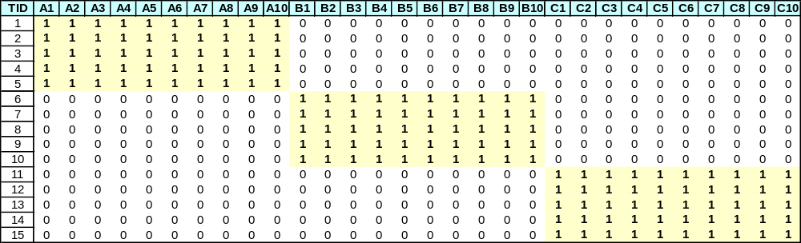
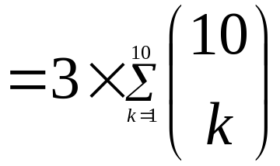
Compact Representation of Frequent Itemsets
Some itemsets are redundant because they have identical support as their supersets
Number of frequent itemsets
Need a compact representation

Slide 38
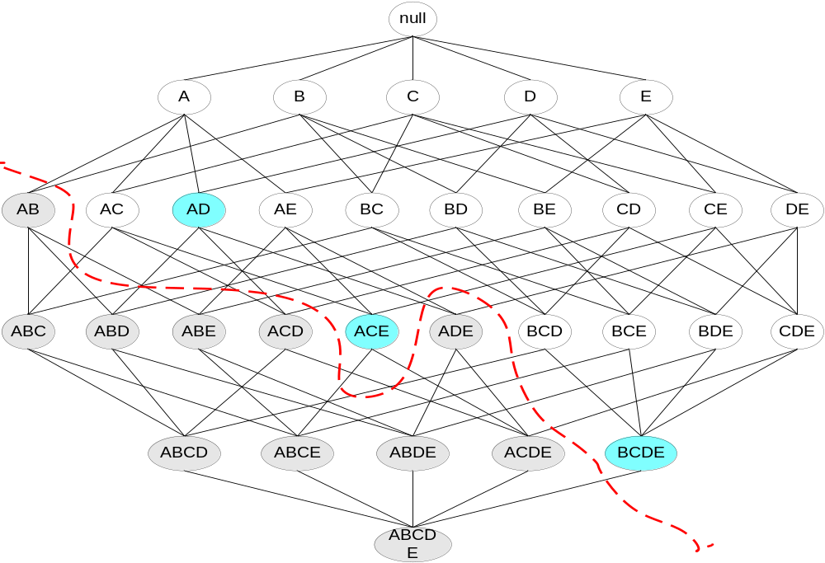
Maximal Frequent Itemset
An itemset is maximal frequent if none of its immediate supersets is frequent
Maximal Itemsets
Infrequent Itemsets
Border

Slide 39
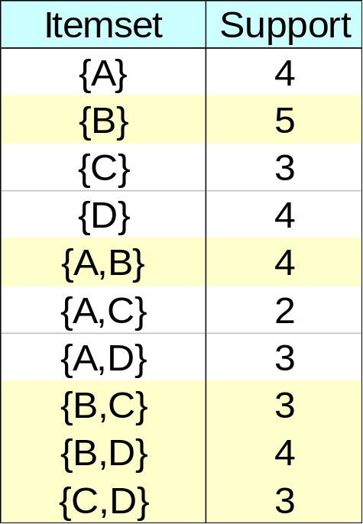
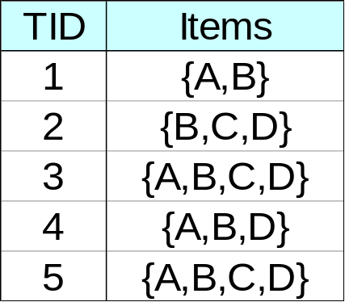
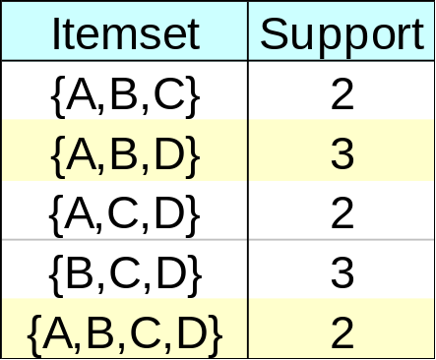
Closed Itemset
An itemset is closed if none of its immediate supersets has the same support as the itemset

Slide 40
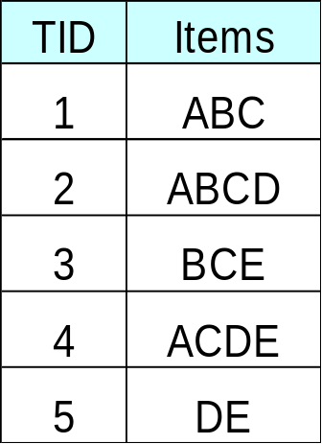
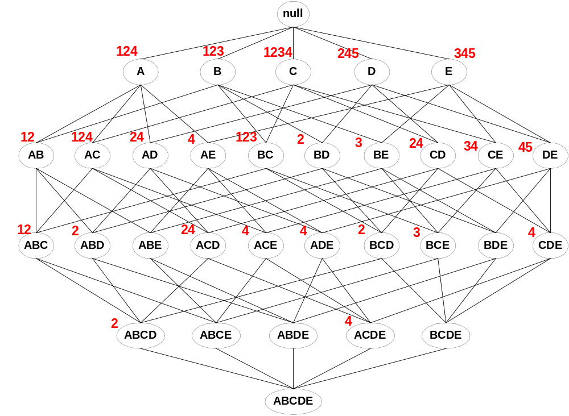
Maximal vs Closed Itemsets
Transaction Ids
Not supported by any transactions

Slide 41
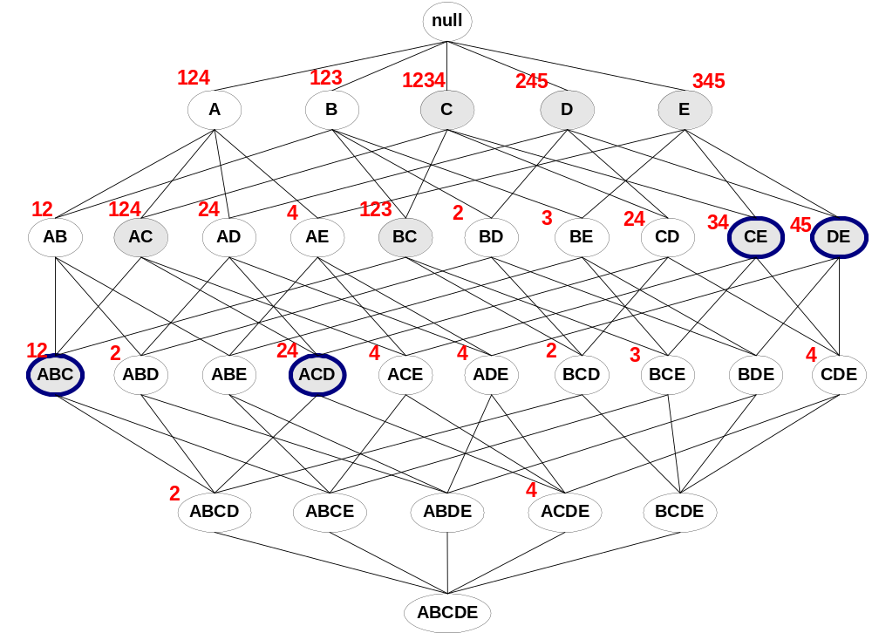
Maximal vs Closed Frequent Itemsets
Minimum support = 2
Closed but not maximal
Closed and maximal
# Closed = 9
# Maximal = 4

Slide 42
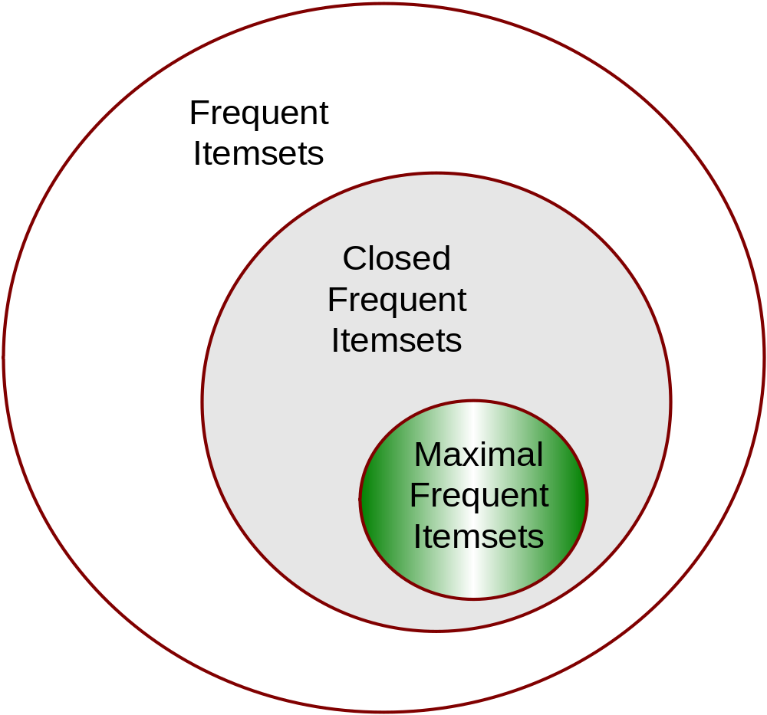
Maximal vs Closed Itemsets

Slide 43
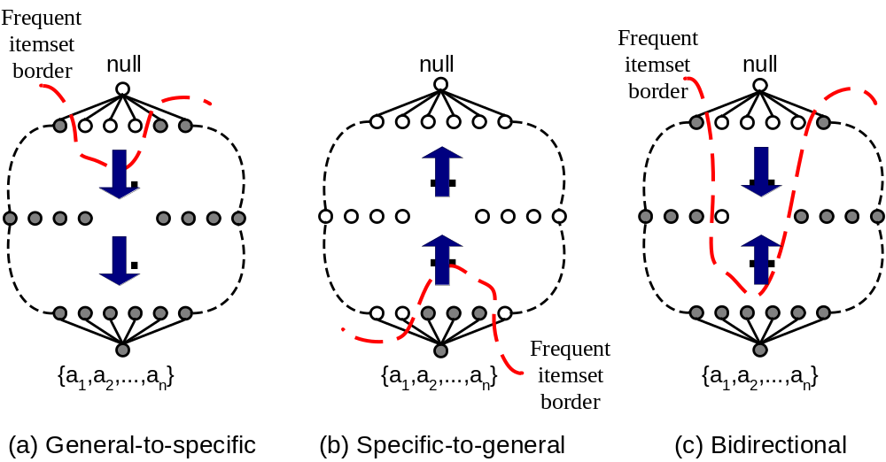
Alternative Methods for Frequent Itemset Generation
Traversal of Itemset Lattice
  General-to-specific vs Specific-to-general

Slide 44
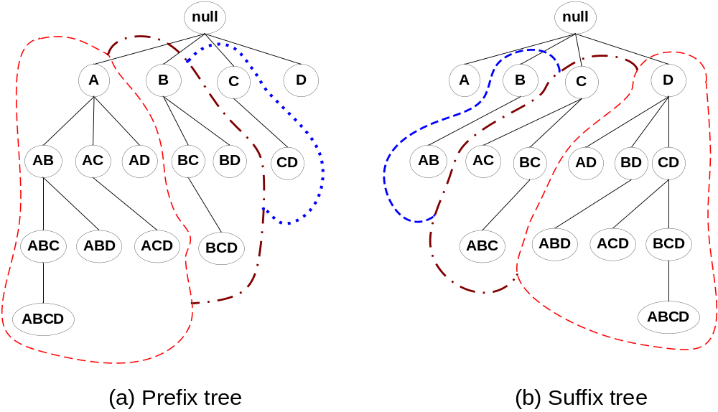
Alternative Methods for Frequent Itemset Generation
Traversal of Itemset Lattice
  Equivalent Classes

Slide 45
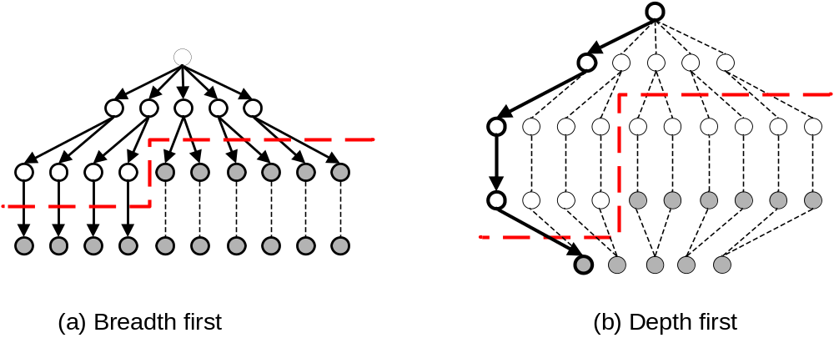
Alternative Methods for Frequent Itemset Generation
Traversal of Itemset Lattice
  Breadth-first vs Depth-first

Slide 46
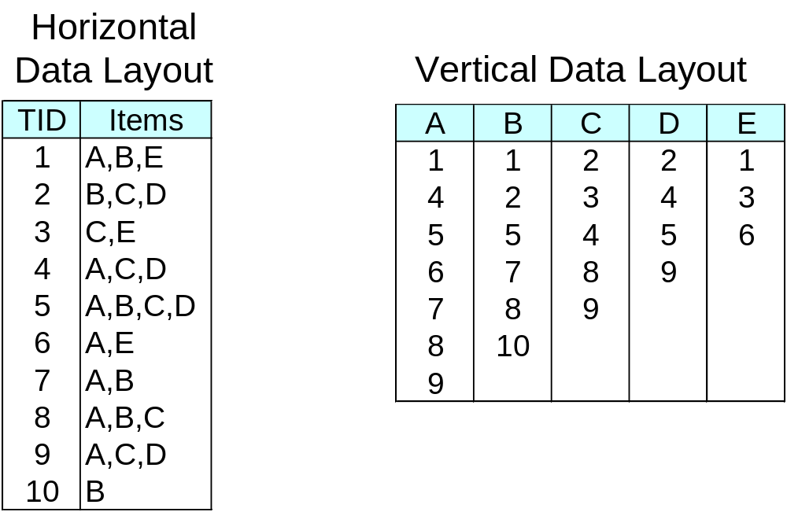
Alternative Methods for Frequent Itemset Generation
Representation of Database
  horizontal vs vertical data layout

Slide 47
Efficient Implementation of Apriori in SQL
Hard to get good performance out of pure SQL (SQL-92) based approaches alone
Make use of object-relational extensions like UDFs, BLOBs, Table functions etc.
  Get orders of magnitude improvement
S. Sarawagi, S. Thomas, and R. Agrawal. Integrating association rule mining with relational database systems: Alternatives and implications. In SIGMOD’98

Slide 48
Challenges of Frequent Pattern Mining
Challenges
  Multiple scans of transaction database
  Huge number of candidates
  Tedious workload of support counting for candidates
Improving Apriori: general ideas
  Reduce passes of transaction database scans
  Shrink number of candidates
  Facilitate support counting of candidates

Slide 49
Partition: Scan Database Only Twice
Any itemset that is potentially frequent in DB must be frequent in at least one of the partitions of DB
  Scan 1: partition database and find local frequent patterns
  Scan 2: consolidate global frequent patterns
A. Savasere, E. Omiecinski, and S. Navathe. An efficient algorithm for mining association in large databases. In VLDB’95

Slide 50
DHP: Reduce the Number of Candidates
A k-itemset whose corresponding hashing bucket count is below the threshold cannot be frequent
  Candidates: a, b, c, d, e
  Hash entries: {ab, ad, ae} {bd, be, de} …
  Frequent 1-itemset: a, b, d, e
  ab is not a candidate 2-itemset if the sum of count of {ab, ad, ae} is below support threshold
J. Park, M. Chen, and P. Yu. An effective hash-based algorithm for mining association rules. In SIGMOD’95

Slide 51
Sampling for Frequent Patterns
Select a sample of original database, mine frequent patterns within sample using Apriori
Scan database once to verify frequent itemsets found in sample, only borders of closure of frequent patterns are checked
  Example: check abcd instead of ab, ac, …, etc.
Scan database again to find missed frequent patterns
H. Toivonen. Sampling large databases for association rules. In VLDB’96

Slide 52
Bottleneck of Frequent-pattern Mining
Multiple database scans are costly
Mining long patterns needs many passes of scanning and generates lots of candidates
  To find frequent itemset i₁i₂…i₁₀₀
    # of scans: 100
    # of Candidates: (₁₀₀¹) + (₁₀₀²) + … + (₁¹₀⁰₀⁰) = 2¹⁰⁰-1 = 1.27*10³⁰ !
Bottleneck: candidate-generation-and-test
Can we avoid candidate generation?

Slide 53
Mining Frequent Patterns Without Candidate Generation
Grow long patterns from short ones using local frequent items
  “abc” is a frequent pattern
  Get all transactions having “abc”: DB|abc
  “d” is a local frequent item in DB|abc → abcd is a frequent pattern

Slide 54
FP-growth Algorithm
Use a compressed representation of the database using an FP-tree
Once an FP-tree has been constructed, it uses a recursive divide-and-conquer approach to mine the frequent itemsets

Slide 55
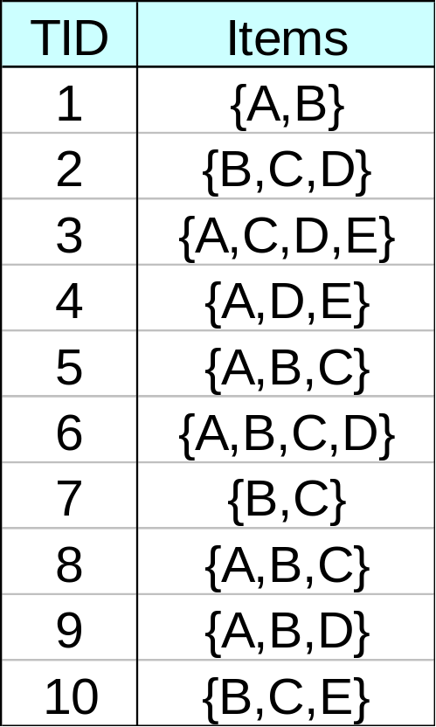
FP-tree construction
null
After reading TID=1:
A:1
B:1
After reading TID=2:
null
A:1
B:1
B:1
C:1
D:1

Slide 56
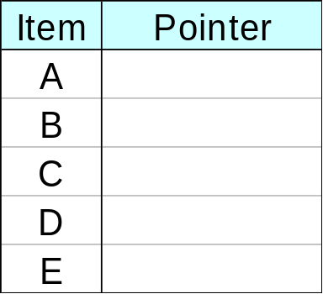
FP-Tree Construction
Transaction Database
null
A:7
B:3
B:5
C:3
C:1
D:1
Header table
D:1
C:3
E:1
D:1
E:1
D:1
E:1
D:1
Pointers are used to assist frequent itemset generation

Slide 57
FP-growth
null
Conditional Pattern base for D:
P = {(A:1,B:1,C:1),
(A:1,B:1),
(A:1,C:1),
(A:1),
(B:1,C:1)}
Recursively apply FP-growth on P
Frequent Itemsets found (with sup > 1):
AD, BD, CD, ACD, BCD
A:7
B:1
B:5
C:1
C:1
D:1
C:3
D:1
D:1
D:1
D:1

Slide 58
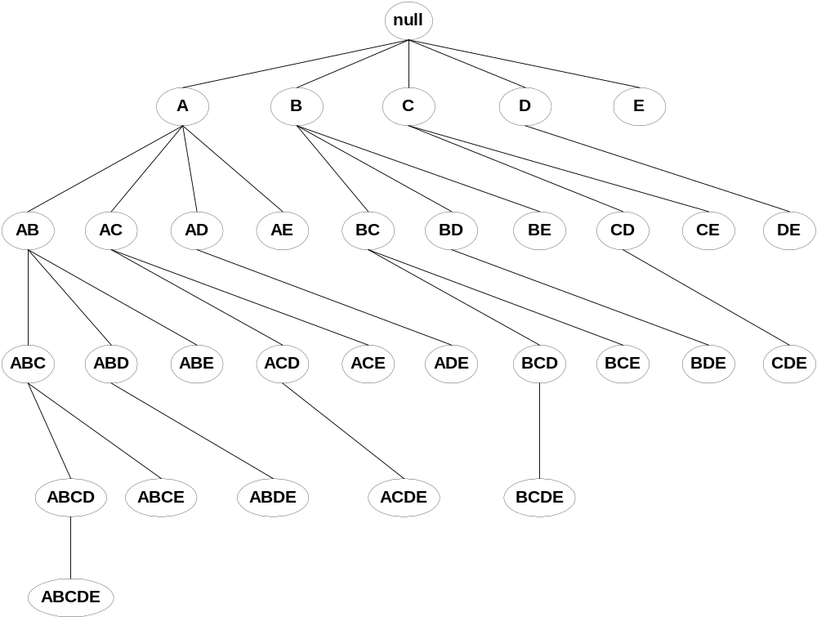
Tree Projection
Set enumeration tree:
Possible Extension: E(A) = {B,C,D,E}
Possible Extension: E(ABC) = {D,E}

Slide 59
Tree Projection
Items are listed in lexicographic order
Each node P stores the following information:
  Itemset for node P
  List of possible lexicographic extensions of P: E(P)
  Pointer to projected database of its ancestor node
  Bitvector containing information about which transactions in the projected database contain the itemset

Slide 60
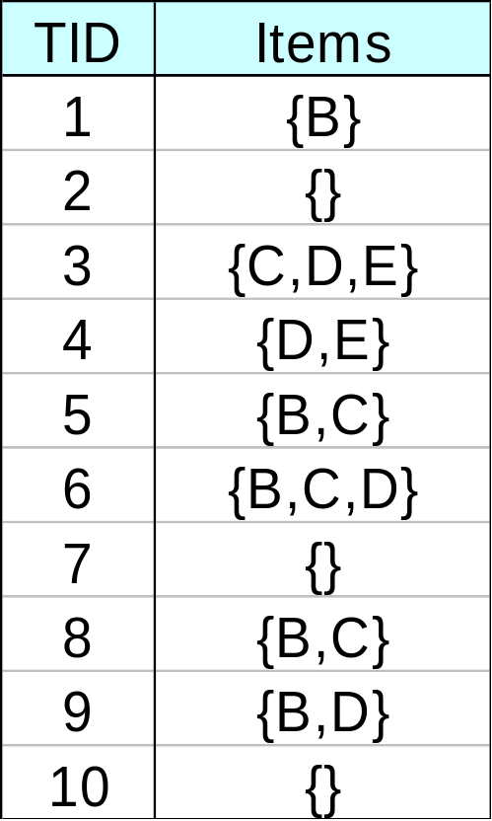
Projected Database
Projected Database for node A:
Original Database:
For each transaction T, projected transaction at node A is T ∩ E(A)

Slide 61
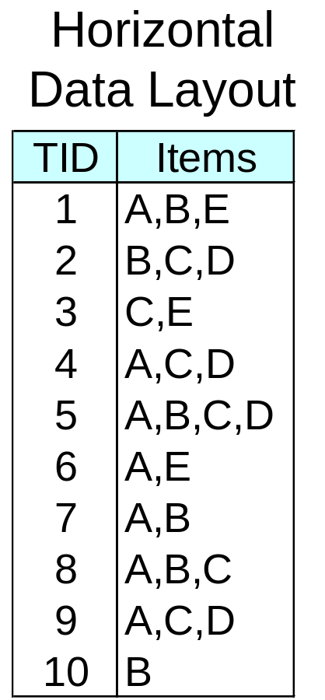
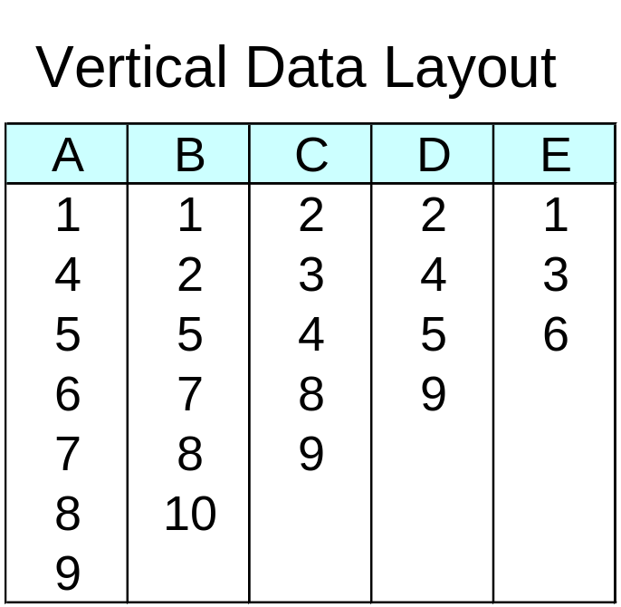
ECLAT
For each item, store a list of transaction ids (tids)
TID-list

Slide 62
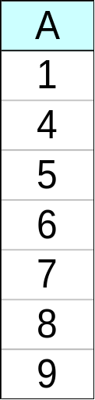
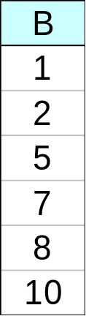
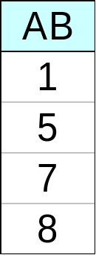
ECLAT
Determine support of any k-itemset by intersecting tid-lists of two of its (k-1) subsets.
3 traversal approaches:
  top-down, bottom-up and hybrid
Advantage: very fast support counting
Disadvantage: intermediate tid-lists may become too large for memory
∧
→

Slide 63
Rule Generation
Given a frequent itemset L, find all non-empty subsets f ⊂ L such that f → L – f satisfies the minimum confidence requirement
  If {A,B,C,D} is a frequent itemset, candidate rules:
    ABC →D, ABD →C, ACD →B, BCD →A,
    A →BCD, B →ACD, C →ABD, D →ABC
    AB →CD, AC → BD, AD → BC, BC →AD,
    BD →AC, CD →AB,
If |L| = k, then there are 2^{k} – 2 candidate association rules (ignoring L → ∅ and ∅ → L)

Slide 64
Rule Generation
How to efficiently generate rules from frequent itemsets?
  In general, confidence does not have an anti-monotone property
    c(ABC →D) can be larger or smaller than c(AB →D)
  But confidence of rules generated from the same itemset has an anti-monotone property
  e.g., L = {A,B,C,D}:
  c(ABC → D) ≥ c(AB → CD) ≥ c(A → BCD)
    Confidence is anti-monotone w.r.t. number of items on the RHS of the rule

Slide 65
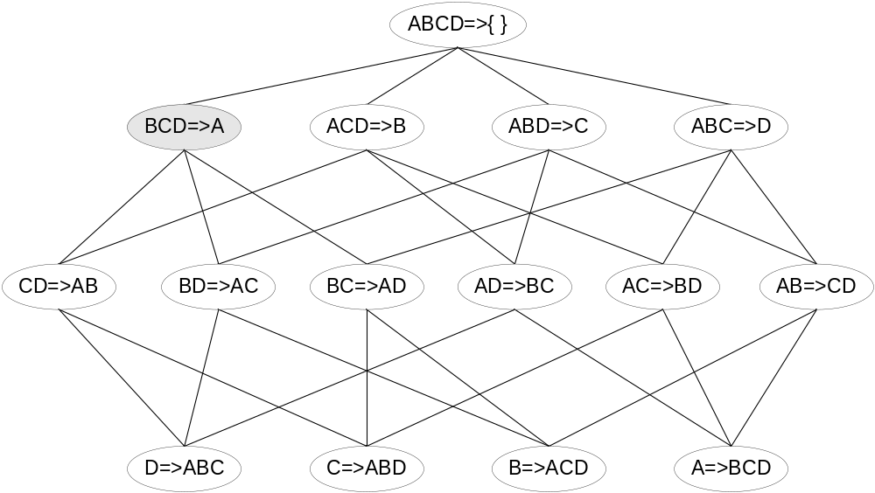

Rule Generation for Apriori Algorithm
Lattice of rules
Low Confidence Rule
Pruned Rules

Slide 66
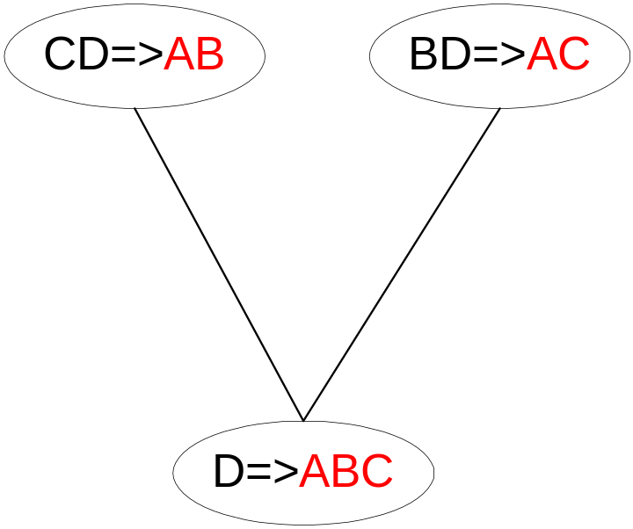
Rule Generation for Apriori Algorithm
Candidate rule is generated by merging two rules that share the same prefix
in the rule consequent
join(CD=>AB,BD=>AC)
would produce the candidate
rule D => ABC
Prune rule D=>ABC if its
subset AD=>BC does not have
high confidence

Slide 67
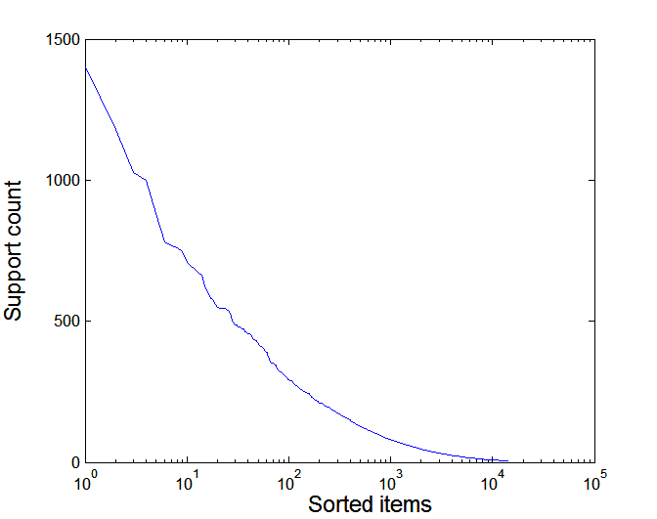
Effect of Support Distribution
Many real data sets have skewed support distribution
Support distribution of a retail data set

Slide 68
Effect of Support Distribution
How to set the appropriate minsup threshold?
  If minsup is set too high, we could miss itemsets involving interesting rare items (e.g., expensive products)
  If minsup is set too low, it is computationally expensive and the number of itemsets is very large
Using a single minimum support threshold may not be effective

Slide 69
Mining Various Kinds of Association Rules
Mining multilevel association
Miming multidimensional association
Mining quantitative association
Mining interesting correlation patterns

Slide 70
Mining Multiple-Level Association Rules
Items often form hierarchies
Flexible support settings
  Items at the lower level are expected to have lower support
Exploration of shared multi-level mining (Agrawal & Srikant@VLB’95, Han & Fu@VLDB’95)
uniform support
reduced support
Level 1
min_sup = 5%
Milk
[support = 10%]
Level 1
min_sup = 5%
Level 2
min_sup = 5%
2% Milk
[support = 6%]
Skim Milk
[support = 4%]
Level 2
min_sup = 3%

Slide 71
Multi-level Association: Redundancy Filtering
Some rules may be redundant due to “ancestor” relationships between items.
Example
  milk ⇒ wheat bread [support = 8%, confidence = 70%]
  2% milk ⇒ wheat bread [support = 2%, confidence = 72%]
We say the first rule is an ancestor of the second rule.
A rule is redundant if its support is close to the “expected” value, based on the rule’s ancestor.

Slide 72
Mining Multi-Dimensional Association
Single-dimensional rules:
    buys(X, “milk”) ⇒ buys(X, “bread”)
Multi-dimensional rules: ≥ 2 dimensions or predicates
  Inter-dimension assoc. rules (no repeated predicates)
    age(X,”19-25”) ∧ occupation(X,“student”) ⇒ buys(X, “coke”)
  hybrid-dimension assoc. rules (repeated predicates)
    age(X,”19-25”) ∧ buys(X, “popcorn”) ⇒ buys(X, “coke”)
Categorical Attributes: finite number of possible values, no ordering among values—data cube approach
Quantitative Attributes: numeric, implicit ordering among values—discretization, clustering, and gradient approaches

Slide 73
Mining Quantitative Associations
Techniques can be categorized by how numerical attributes, such as age or salary are treated
Static discretization based on predefined concept hierarchies (data cube methods)
Dynamic discretization based on data distribution (quantitative rules, e.g., Agrawal & Srikant@SIGMOD96)
Clustering: Distance-based association (e.g., Yang & Miller@SIGMOD97)
  one dimensional clustering then association
Deviation: (such as Aumann and Lindell@KDD99)
  Sex = female => Wage: mean=$7/hr (overall mean = $9)

Slide 74
Static Discretization of Quantitative Attributes
Discretized prior to mining using concept hierarchy.
Numeric values are replaced by ranges.
In relational database, finding all frequent k-predicate sets will require k or k+1 table scans.
Data cube is well suited for mining.
The cells of an n-dimensional
  cuboid correspond to the
  predicate sets.
Mining from data cubes
can be much faster.
()
(age)
(income)
(buys)
(age, income)
(age,buys)
(income,buys)
(age,income,buys)

Slide 75

Quantitative Association Rules
Proposed by Lent, Swami and Widom ICDE’97
Numeric attributes are dynamically discretized
  Such that the confidence or compactness of the rules mined is maximized
2-D quantitative association rules: A_{quan1} ∧ A_{quan2} ⇒ A_{cat}
Cluster adjacent association rules to form general rules using a 2-D grid
Example
age(X,”34-35”) ∧ income(X,”30-50K”)
⇒ buys(X,”high resolution TV”)

Slide 76
Mining Other Interesting Patterns
Flexible support constraints (Wang et al. @ VLDB’02)
  Some items (e.g., diamond) may occur rarely but are valuable
  Customized sup_{min} specification and application
Top-K closed frequent patterns (Han, et al. @ ICDM’02)
  Hard to specify sup_{min}, but top-k with length_{min} is more desirable
  Dynamically raise sup_{min} in FP-tree construction and mining, and select most promising path to mine

Slide 77
Pattern Evaluation
Association rule algorithms tend to produce too many rules
  many of them are uninteresting or redundant
  Redundant if {A,B,C} → {D} and {A,B} → {D}
  have same support & confidence
Interestingness measures can be used to prune/rank the derived patterns
In the original formulation of association rules, support & confidence are the only measures used

Slide 78
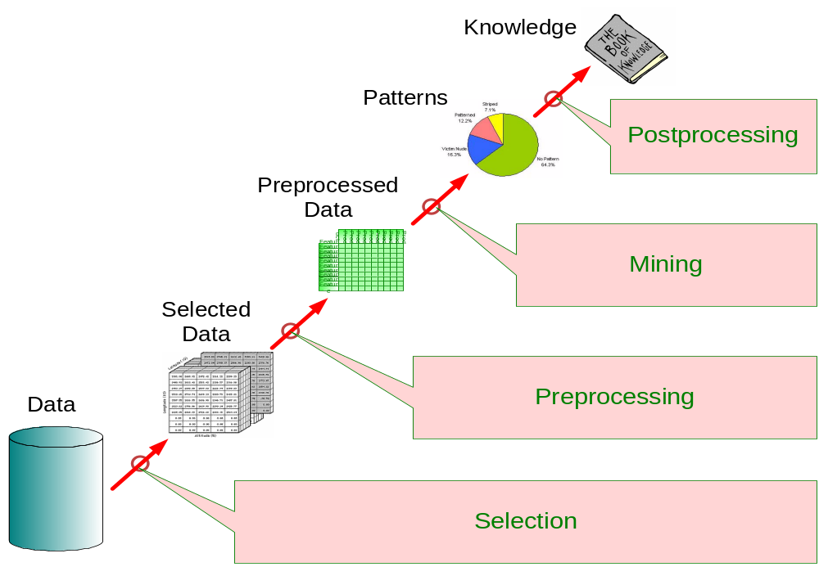
Application of Interestingness Measure
Interestingness Measures

Slide 79
Computing Interestingness Measure
Given a rule X → Y, information needed to compute rule interestingness can be obtained from a contingency table
Contingency table for X → Y
 | Y | Y
X | f₁₁ | f₁₀ | f₁₊
X | f₀₁ | f₀₀ | f_{o+}
 | f₊₁ | f₊₀ | |T|
f₁₁: support of X and Y
f₁₀: support of X and Y
f₀₁: support of X and Y
f₀₀: support of X and Y
Used to define various measures
support, confidence, lift, Gini,
J-measure, etc.

Slide 80
Drawback of Confidence
 | Coffee | Coffee
Tea | 15 | 5 | 20
Tea | 75 | 5 | 80
 | 90 | 10 | 100
Association Rule: Tea → Coffee
Confidence= P(Coffee|Tea) = 0.75
but P(Coffee) = 0.9
Although confidence is high, rule is misleading
P(Coffee|Tea) = 0.9375

Slide 81
Statistical Independence
Population of 1000 students
  600 students know how to swim (S)
  700 students know how to bike (B)
  420 students know how to swim and bike (S,B)
  P(S∧B) = 420/1000 = 0.42
  P(S) × P(B) = 0.6 × 0.7 = 0.42
  P(S∧B) = P(S) × P(B) => Statistical independence
  P(S∧B) > P(S) × P(B) => Positively correlated
  P(S∧B) < P(S) × P(B) => Negatively correlated

Slide 82
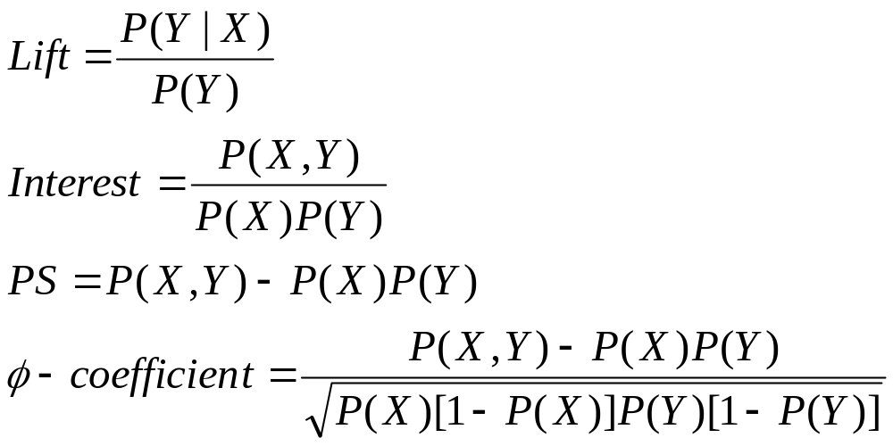
Statistical-based Measures
Measures that take into account statistical dependence

Slide 83
Example: Lift/Interest
 | Coffee | Coffee
Tea | 15 | 5 | 20
Tea | 75 | 5 | 80
 | 90 | 10 | 100
Association Rule: Tea → Coffee
Confidence= P(Coffee|Tea) = 0.75
but P(Coffee) = 0.9
Lift = 0.75/0.9= 0.8333 (< 1, therefore is negatively associated)

Slide 84
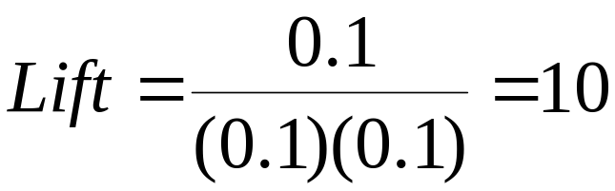
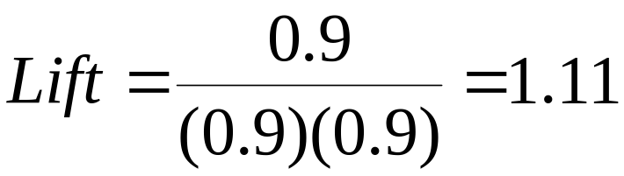
Drawback of Lift & Interest
 | Y | Y
X | 10 | 0 | 10
X | 0 | 90 | 90
 | 10 | 90 | 100
 | Y | Y
X | 90 | 0 | 90
X | 0 | 10 | 10
 | 90 | 10 | 100
Statistical independence:
If P(X,Y)=P(X)P(Y) => Lift = 1

Slide 85
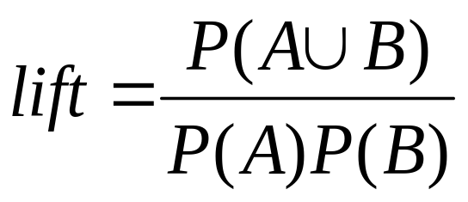
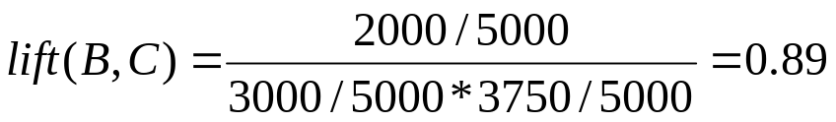
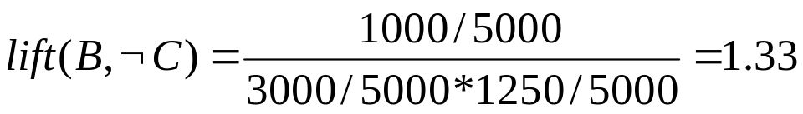
Interestingness Measure: Correlations (Lift)
play basketball ⇒ eat cereal [40%, 66.7%] is misleading
  The overall % of students eating cereal is 75% > 66.7%.
play basketball ⇒ not eat cereal [20%, 33.3%] is more accurate, although with lower support and confidence
Measure of dependent/correlated events: lift
 | Basketball | Not basketball | Sum (row)
Cereal | 2000 | 1750 | 3750
Not cereal | 1000 | 250 | 1250
Sum(col.) | 3000 | 2000 | 5000

Slide 86
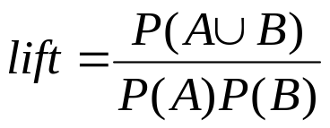
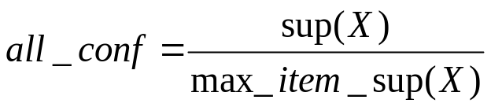
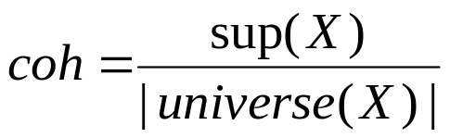
Are lift and χ² Good Measures of Correlation?
“Buy walnuts ⇒ buy milk [1%, 80%]” is misleading
  if 85% of customers buy milk
Support and confidence are not good to represent correlations
So many interestingness measures? (Tan, Kumar, Sritastava @KDD’02)
 | Milk | No Milk | Sum (row)
Coffee | m, c | ~m, c | c
No Coffee | m, ~c | ~m, ~c | ~c
Sum(col.) | m | ~m | Σ
DB | m, c | ~m, c | m~c | ~m~c | lift | all-conf | coh | χ2
A1 | 1000 | 100 | 100 | 10,000 | 9.26 | 0.91 | 0.83 | 9055
A2 | 100 | 1000 | 1000 | 100,000 | 8.44 | 0.09 | 0.05 | 670
A3 | 1000 | 100 | 10000 | 100,000 | 9.18 | 0.09 | 0.09 | 8172
A4 | 1000 | 1000 | 1000 | 1000 | 1 | 0.5 | 0.33 | 0

Slide 87

Which Measures Should Be Used?
lift and χ² are not good measures for correlations in large transactional DBs
all-conf or coherence could be good measures (Omiecinski@TKDE’03)
Both all-conf and coherence have the downward closure property
Efficient algorithms can be derived for mining (Lee et al. @ICDM’03sub)

Slide 88
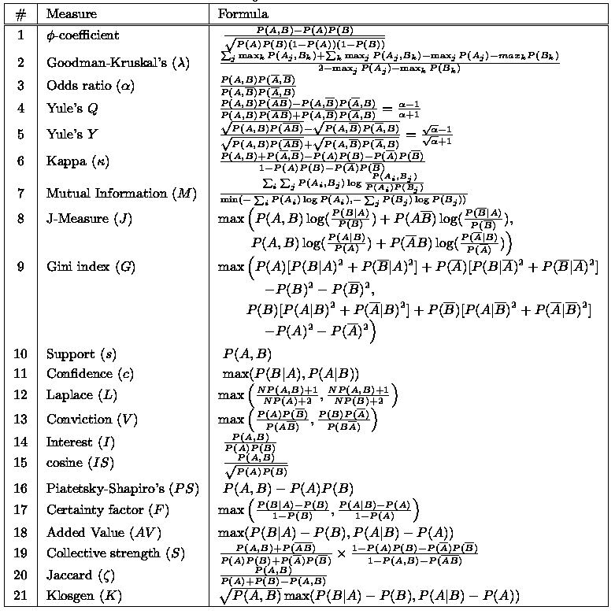
There are lots of measures proposed in the literature
Some measures are good for certain applications, but not for others
What criteria should we use to determine whether a measure is good or bad?
What about Apriori-style support based pruning? How does it affect these measures?

Slide 89
Support-based Pruning
Most of the association rule mining algorithms use support measure to prune rules and itemsets
Study effect of support pruning on correlation of itemsets
  Generate 10000 random contingency tables
  Compute support and pairwise correlation for each table
  Apply support-based pruning and examine the tables that are removed

Slide 90
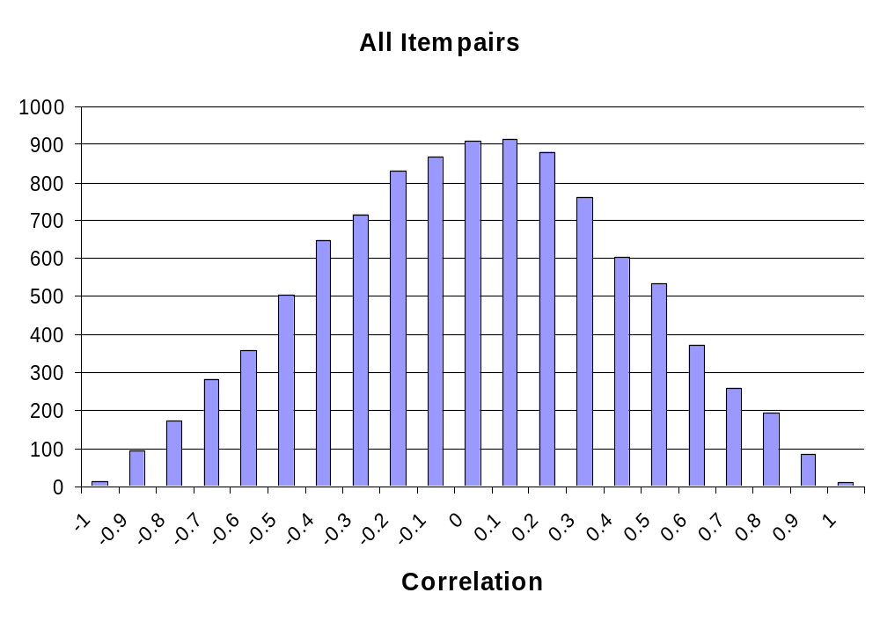
Effect of Support-based Pruning

Slide 91
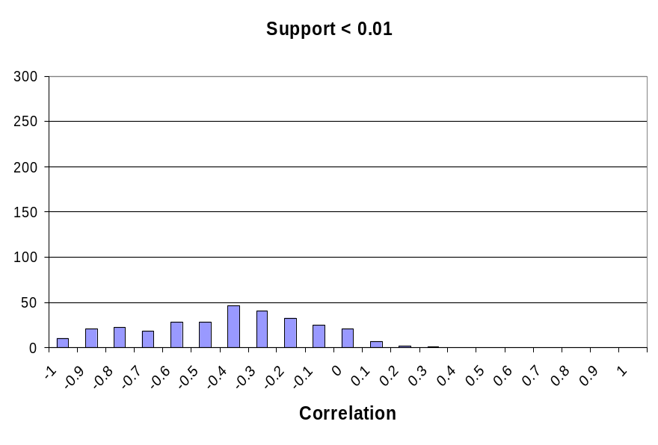
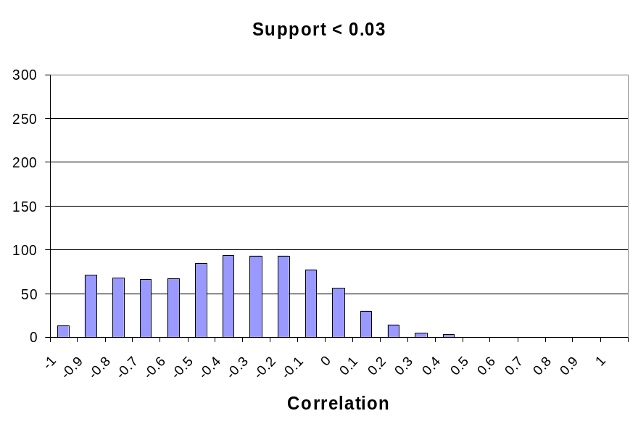
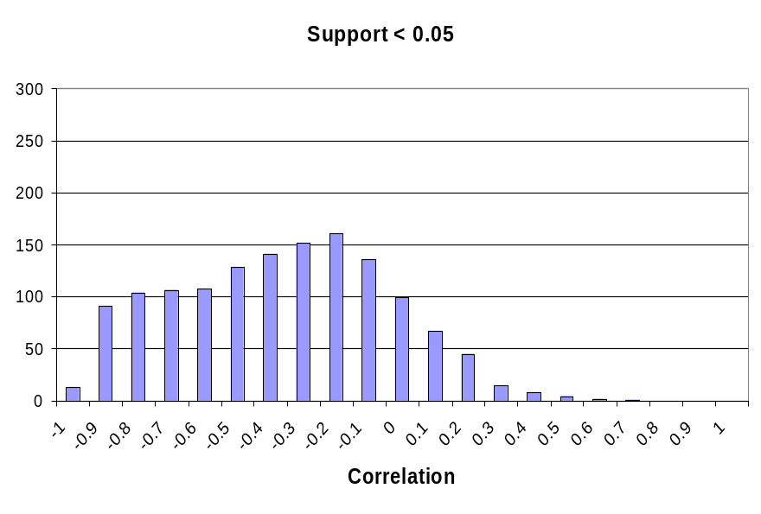
Effect of Support-based Pruning
Support-based pruning eliminates mostly negatively correlated itemsets

Slide 92
Effect of Support-based Pruning
Investigate how support-based pruning affects other measures
Steps:
  Generate 10000 contingency tables
  Rank each table according to the different measures
  Compute the pair-wise correlation between the measures

Slide 93
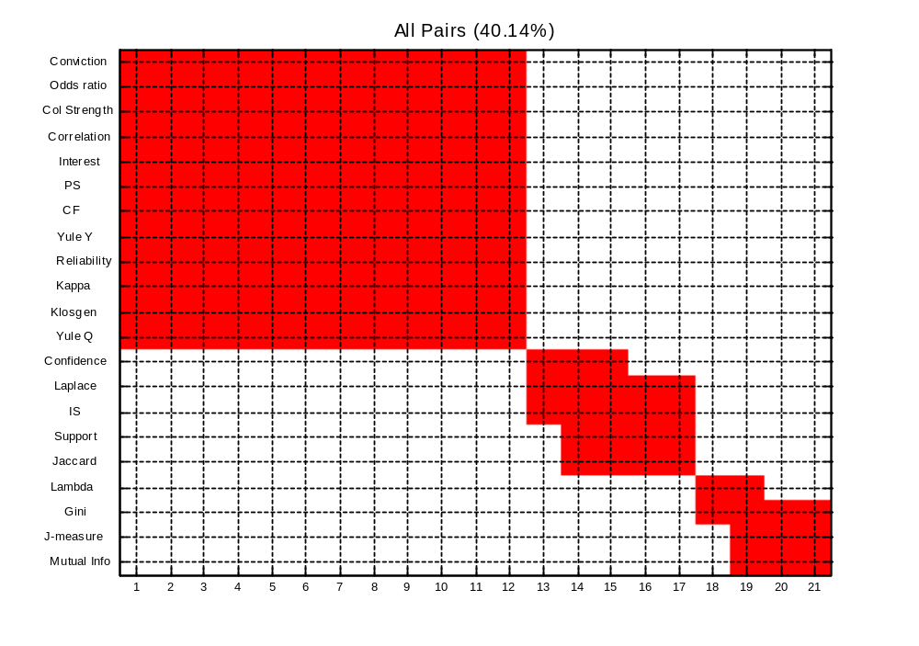
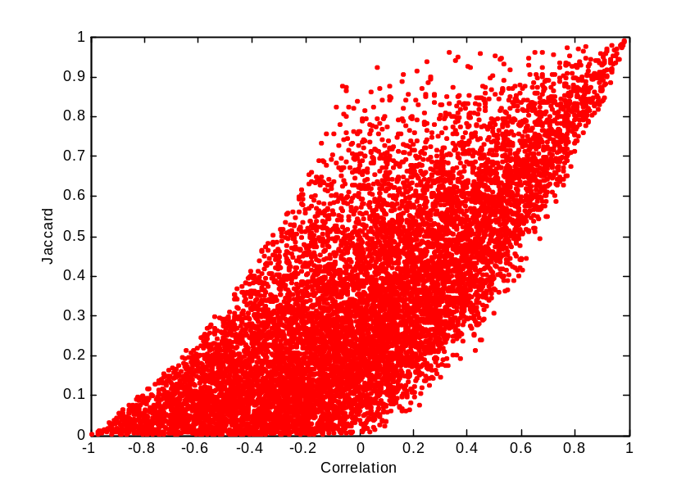
Effect of Support-based Pruning
Without Support Pruning (All Pairs)
Scatter Plot between Correlation & Jaccard Measure
Red cells indicate correlation between
the pair of measures > 0.85
40.14% pairs have correlation > 0.85

Slide 94


Effect of Support-based Pruning
0.5% ≤ support ≤ 50%
Scatter Plot between Correlation & Jaccard Measure:
61.45% pairs have correlation > 0.85

Slide 95


Effect of Support-based Pruning
0.5% ≤ support ≤ 30%
Scatter Plot between Correlation & Jaccard Measure
76.42% pairs have correlation > 0.85

Slide 96
Subjective Interestingness Measure
Objective measure:
  Rank patterns based on statistics computed from data
  e.g., 21 measures of association (support, confidence, Laplace, Gini, mutual information, Jaccard, etc).
Subjective measure:
  Rank patterns according to user’s interpretation
    A pattern is subjectively interesting if it contradicts the
    expectation of a user (Silberschatz & Tuzhilin)
    A pattern is subjectively interesting if it is actionable
    (Silberschatz & Tuzhilin)

Slide 97

Interestingness via Unexpectedness
Need to model expectation of users (domain knowledge)
Need to combine expectation of users with evidence from data (i.e., extracted patterns)
+
Pattern expected to be frequent
-
Pattern expected to be infrequent
Pattern found to be frequent
Pattern found to be infrequent
+
-
Expected Patterns
-
+
Unexpected Patterns

Slide 98

Interestingness via Unexpectedness
Web Data (Cooley et al 2001)
  Domain knowledge in the form of site structure
  Given an itemset F = {X₁, X₂, …, X_{k}} (X_{i} : Web pages)
    L: number of links connecting the pages
    lfactor = L / (k × k-1)
    cfactor = 1 (if graph is connected), 0 (disconnected graph)
  Structure evidence = cfactor × lfactor
  Usage evidence
  Use Dempster-Shafer theory to combine domain knowledge and evidence from data

